Slide 1

SkinXpert:
Decode Your Skin, Unlock Your Glow
Azra Attar 23107037
Vaishnavi Jadhav 23107051
Sanjana Naik 23107035
Sharvari Kadam 23107026
Project Guide
Ms. Richa Singh

Slide 2
Contents
Introduction
Objectives
Scope
Features / Functionality
Project Outcomes
Technology Stack
Block Diagram if applicable

Slide 3
1. Introduction
Problem Identified :
People of different age groups often struggle to choose the right skincare products due to the wide variety availablity in the market, many of which may not be suitable for their specific skin needs.
Solution Proposed :
Through a quick quiz, we analyze your unique skin concerns, such as acne, dryness, or sensitivity, and propose the best products to suit your needs.

Slide 4
2. Objectives
To develop an interactive quiz using Tkinter to identify users' specific skincare concerns based on their answers.
To provide users with a tailored skincare routine designed to address their identified concerns effectively.
To display a curated list of products containing key ingredients to target users' unique skincare issues.
To give features like add to cart, delete item from cart etc.

Slide 5
3. Scope
Can be useful to individuals looking for personalized skincare routines and home remedies.
Can be applied in dermatology clinics for offering tailored skin care plans to clients.
Can be useful to beauty enthusiasts seeking specific skin care advice based on their skin type.
Can be useful for people who are just getting started with their skincare journey.

Slide 6
4. Feature /Functionality
Feature 1: An interactive Quiz to determine your skin type.
Feature 2: Curated list of products according to your skin type.
Feature 3: List of ingredients that suit your skin type and target your skin issues.
Feature 4: Different section for home remedies.
Feature 5: Gives a basic skin care routine with tips.
Feature 6: A Skin advisor that answers most commonly asked questions

Slide 7
5. Outcome of Project
User can take a quiz to identify their skin type based on a series of questions, and based on the quiz answers user’s skin type is displayed.
User can search for skincare products.
User can access home remedies for skincare.
System saves the user’s quiz result for future reference.

Slide 8
6. Technology Stack
Front End:-
Tkinter: is a Python library for creating simple graphical user interface(GUIs) with buttons, windows, and other interactive features. It works on all major operating systems.
Back End:-
MySQL: Open-source relational database management system (RDBMS).

Slide 9
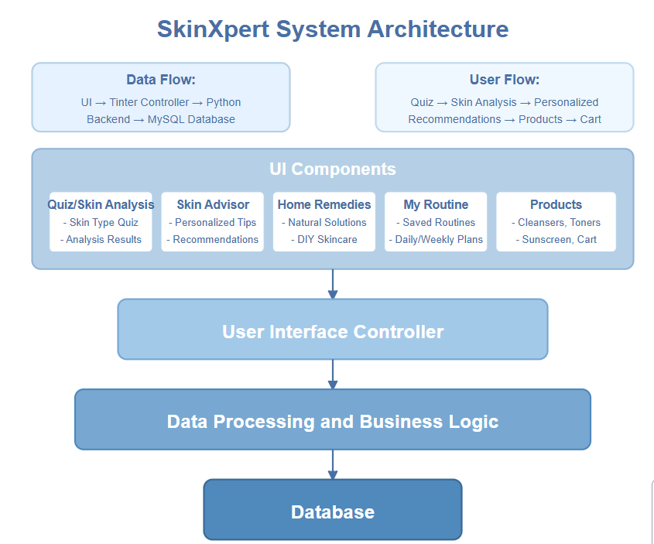
7. Block Diagram

Slide 10
Thank You...!!

